Slide 1

Cyber Threat Intelligence Elania Resources 21 Mac 2020
Perak Technology Academy

Slide 2
Elania Resources
Bumiputera company that provides services to develop mobile apps, websites, web applications and e-commerce
Established on March 4, 2015
Founded by 2 person who passionate in ICT and technology field.
Created Perak Technology to boost ICT and technology industries in Perak.
Link: https://elaniaresources.com

Slide 3
P3R4K
Professional Principal Provider Refinement For Knowledge (P3R4K)
Penyempurnaan Penyedia Utama Profesional Untuk Ilmu Pengetahuan
Elania Resources Telah Mewujudkan Komuniti ICT Perak Technology Pada Tahun 2016
Memiliki seramai lebih dari 3000 orang ahli yang aktif di Telegram

Slide 4
Objektif P3R4K
Penyediaan Golongan Profesional Dalam Industri ICT dan Teknologi
Meningkatkan Kemahiran Golongan Belia Dalam Bidang Latihan dan Pembelajaran
Meningkatkan Industri ICT dan Teknologi Di Negeri Perak
Mengatasi Masalah Pengangguran Di Kalangan Golongan Belia Di Negeri Perak

Slide 5
Perak Technology Academy
Terbuka Kepada Seluruh Penduduk Di Negeri Perak Yang Berumur 18 Keatas
Dilaksanakan Secara Maya Samada Melalui Skype dan Google Classroom
Tenaga Pengajar Dari Kalangan Ahli Atau Jemputan Dari Agensi Luar
Pembelajaran Merangkumi Pelbagai Bidang ICT dan Teknologi

Slide 6
Cyber Threat Intelligence
Collected cyber threat information
Evaluated source and reliability
Analyzed through different technique
Identifying threats and opportunities
Identify similarities and differences
Detect deceptions to produce accurate, timely, and relevant intelligence

Slide 7
Intelligence Cycle
Planned data collection
Data implemented, and evaluated
Data analyzed to produce intelligence
Intelligence is disseminated and re-evaluated
Analysis differentiates intelligence from information gathering

Slide 8
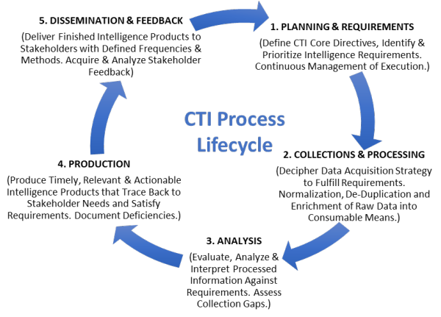
CTI Process Lifecycle

Slide 9
Benefit
Chief Information Security Officers (CISOs)
provides value for other experts
provide greater insight into cyber threats
develop a proactive cybersecurity posture
improved detection of threats
better decision-making during cyber intrusion

Slide 10
Types of CTI
Strategic — Broader trends typically meant for a non-technical audience
Tactical — Outlines of the tactics, techniques, and procedures of threat actors for a more technical audience
Operational — Technical details about specific attacks and campaigns

Slide 11
Use Cases
Incident Response
Security Operations
Vulnerability Management
Risk Analysis
Fraud Prevention
Security Leadership

Slide 12
Tools
SIEM
Next-Generation Firewall
Intrusion Detection
Malware Analysis
Security Trails
Threat Map

Slide 13
Example
IBM X-Force Exchange
FireEye iSIGHT Threat Intelligence
AlienVault Unified Security Management (USM)
ThreatConnect
Symantec DeepSight Intelligence
Palo Alto Networks AutoFocus

Slide 14
Perak Technology Academy
https://academy.peraktechnology.com
https://t.me/peraktechnology
https://t.me/elaniaresources

